Slide 1

Easy Steps to Start with GitHub
Notes:
In this presentation, we will go through the 6 steps to get started with GitHub, from creating an account to using GitHub Copilot.

Slide 2

Presentation Overview
Creating a GitHub Account
Creating a GitHub account is the first step in using Git and GitHub. It's easy to create an account, and it gives you access to a wide range of features and tools that are useful for software development.
Setting Up Git
Setting up Git is essential for using GitHub. We will cover how to install Git on your computer and configure it for your needs.
Creating a New Repository
A repository is a place to store your code and collaborate with others. We will cover how to create a new repository on GitHub and how to push code to it.
Using Basic Git Commands
Git has a variety of commands that you can use to work with code. We will cover the most important ones, including add, commit, push, pull, and merge.
Using GitHub Copilot
GitHub Copilot is an AI-powered code assistant that can help you write code faster and more efficiently. We will cover how to use it and some of its key features.
Notes:
We will start with creating a GitHub account, then move on to setting up Git, creating a new repository, cloning a repository, using basic Git commands, and finally, using GitHub Copilot.

Slide 3

Create a GitHub Account
To get started with GitHub, the first step is to create an account. Sign up at GitHub.com by filling in your details and choosing a username and password.
Notes:
The first step to getting started with GitHub is to create an account. You can sign up at GitHub.com by filling in your details and choosing a username and password.

Slide 4

Set Up Git
Git Download and Install
To set up Git, you need to download and install Git on your computer. You can download Git for Windows, Mac, or Linux operating systems from the official Git website.
Windows: Download and install from Git for Windows
Mac: Install via Homebrew: ‘brew install git’.
Linux: Use the package manager, e.g.,’ sudo apt-get install git’
Configure Git
Once Git is installed, you need to configure it with your name and email address. This information will be used to identify you as the author of your code changes.
Notes:
Git is a version control system that allows you to track changes to your code. To set up Git, you need to download and install Git, and configure it with your name and email address.

Slide 5

Install Git: Git Downloads
To download Git, you can visit the Git Downloads page on the official Git website where you can find instructions and links to download Git for your platform.
Notes:
You can download Git from the Git Downloads page on the official Git website.

Slide 6
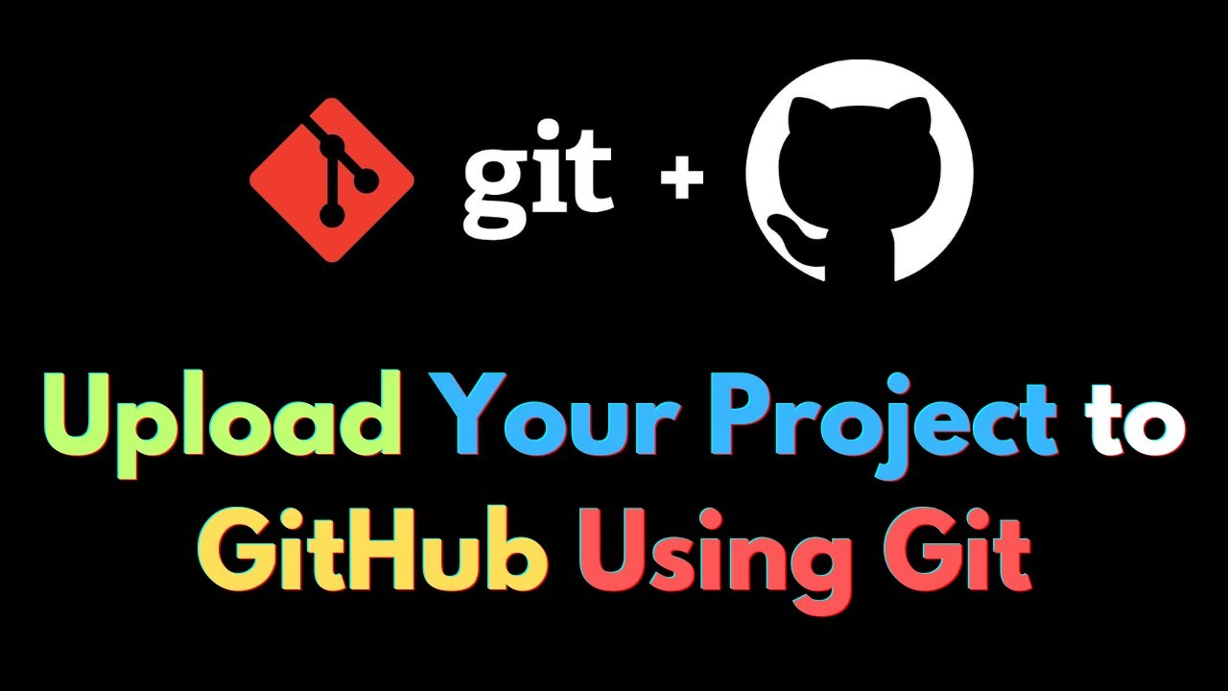
Configure Git
To configure Git with your name and email address, use the following commands:
git config --global user.name 'Your Name’
2. git config --global user.email 'you@example.com' This ensures Git can associate your changes with your identity.
Notes:
After installing Git, you need to configure it with your name and email address. This allows Git to associate your changes with your identity.

Slide 7

Navigate to GitHub
To navigate to GitHub, open your preferred web browser and go to the GitHub website.
Notes:
To navigate to GitHub, open your web browser and go to the GitHub website.

Slide 8
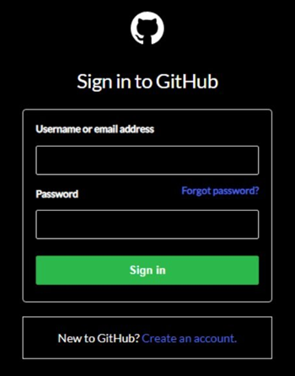
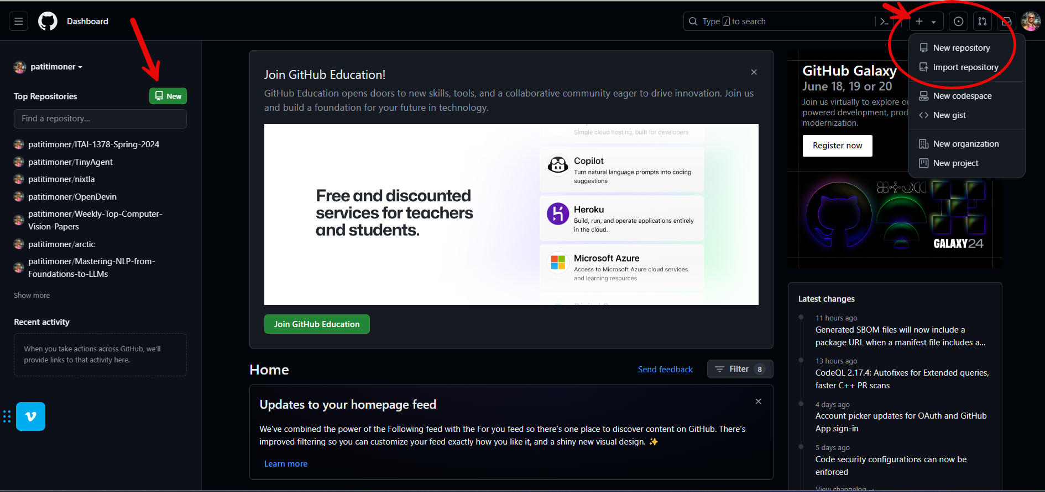
Accessing GitHub Dashboard
To create a new repository on GitHub, first, log in to your account and access the GitHub dashboard.
Creating New Repository
Once you are logged in to GitHub, click the 'New Repository' button on your dashboard to create a new repository.
Notes:
Once you are logged in to GitHub, you can click the 'New Repository' button on your dashboard to create a new repository.

Slide 9
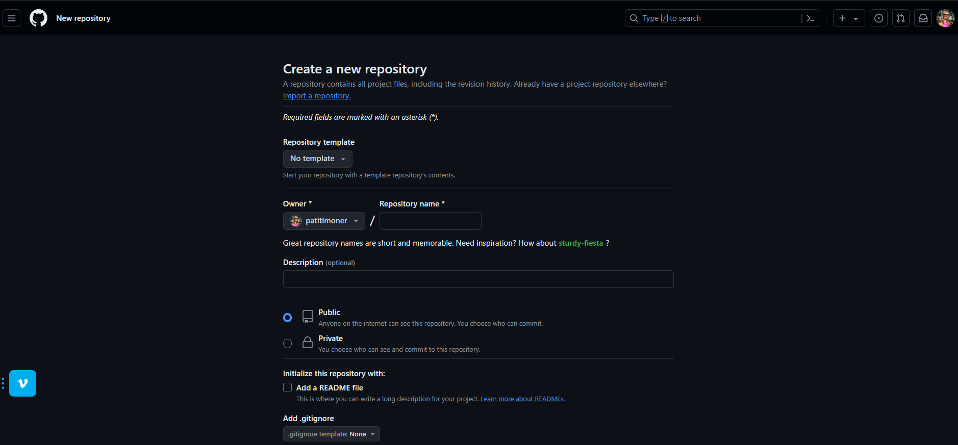
Fill in Details and Create the Repository
Fill in Repository Details
Provide accurate details for your repository like the name, description, and visibility.
Create Repository
Once you have filled in all the necessary details, create the repository.
Notes:
You will need to fill in the details of your new repository, such as the name, description, and visibility. Then, you can create the repository.

Slide 10

Cloning a Repository
After creating a repository on GitHub, you can clone it to your local machine using Git. Cloning creates a copy of the code in your local system that you can modify and push back to the remote repository.
Notes:
Once you have created a repository on GitHub, you can clone it to your local machine using Git.

Slide 11

Command: git clone https://github.com/yourusername/repositoryname.git
Cloning a Repository
To clone a repository, you can use the 'git clone' command followed by the URL of your repository. This will create a local copy of the repository on your machine.
URL of Repository
When cloning a repository, you need to specify the URL of the repository. This URL can be found on the repository's page on GitHub or another version control system.
Notes:
To clone a repository, you need to run the command 'git clone' followed by the URL of your repository.

Slide 12

Cloning a GitHub repository allows you to:
Access the Latest Code: Get the most recent codebase version.
Work Locally: Develop, test, and modify code on your local machine or preferred Integrated Development Environment (IDE) like Colab or Sagemaker Studio Lab.
Version Control: Track changes, collaborate with others and contribute back to the project.

Slide 13
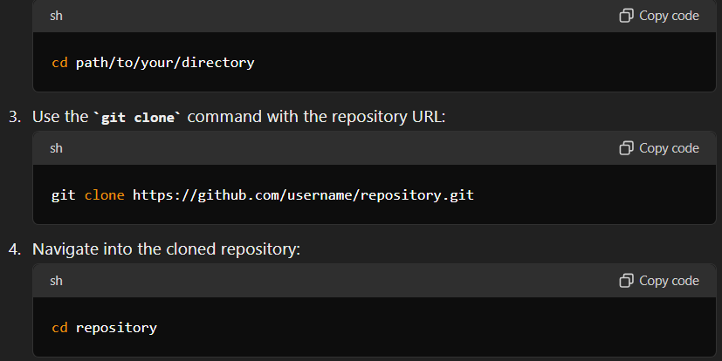
Using Command Line (Local Machine):
Open your terminal (Command Prompt, PowerShell, or terminal on macOS/Linux).
Navigate to the directory where you want to clone the repository

Slide 14
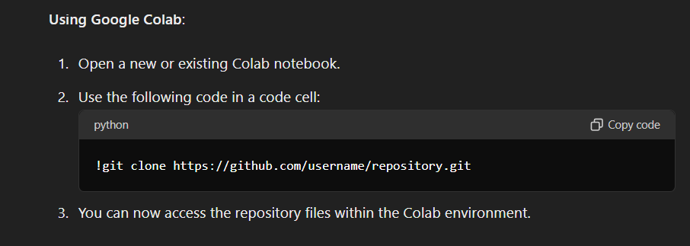
Using Google Colab

Slide 15
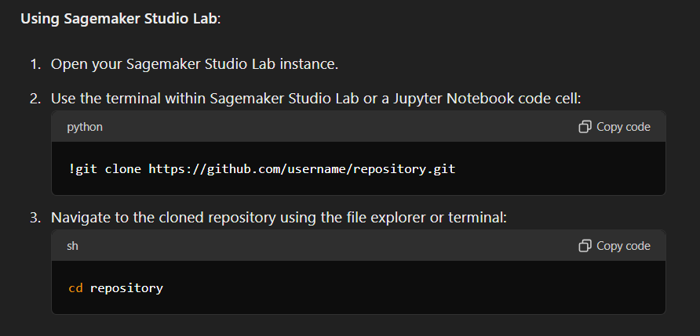
Using Sagemaker Studio Lab:

Slide 16

Basic Git Commands
git init
The 'git init' command is used to initialize a new Git repository.
git add
The 'git add' command is used to add changes to the staging area for the next commit.
git commit
The 'git commit' command is used to save changes to the local repository.
Notes:
Now that you have set up Git and created a repository, you can start using basic Git commands to manage your code.

Slide 17

git add .: Add changes to staging area
Staging changes allows you to review your changes before committing them. Use 'git add .' command to stage changes for a commit.
Notes:
To stage changes for a commit, you can use the command 'git add .' This will add all changes to the staging area.

Slide 18

git commit -m 'commit message': Commit changes
Git Commit Command
Git commit command is used to save changes to your local repository. To commit changes, use the command 'git commit' followed by a commit message that describes the changes you made.
Commit Message
The commit message is a brief description of the changes you made. It helps other developers understand the changes you made and why you made them.
Notes:
To commit changes to your repository, you need to use the command 'git commit' followed by a commit message that describes the changes you made.

Slide 19

git push origin main: Push changes to GitHub
To push changes to your GitHub repository, use the 'git push' command followed by the name of your remote repository and branch. This will push your changes to the specified branch and update your repository on GitHub.
Notes:
To push changes to your GitHub repository, you need to use the command 'git push' followed by the name of your remote repository and branch.

Slide 20

Using GitHub Copilot
GitHub Copilot is an AI-powered code assistant that uses machine learning to help you write code more quickly and efficiently. It can suggest entire lines of code, complete functions, and offer helpful suggestions as you write.
Notes:
GitHub Copilot is an AI-powered code assistant that can help you write code more quickly and efficiently.

Slide 21

Install Visual Studio Code: VS Code Download
To use GitHub Copilot, you need to install Visual Studio Code, a popular code editor. You can download it from the official VS Code website.
Notes:
To use GitHub Copilot, you need to install Visual Studio Code, a popular code editor. You can download it from the official VS Code website.

Slide 22
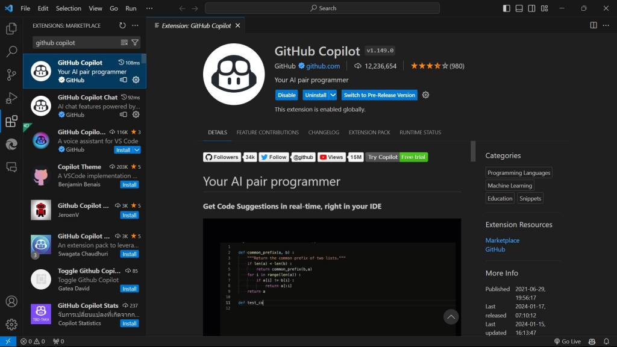
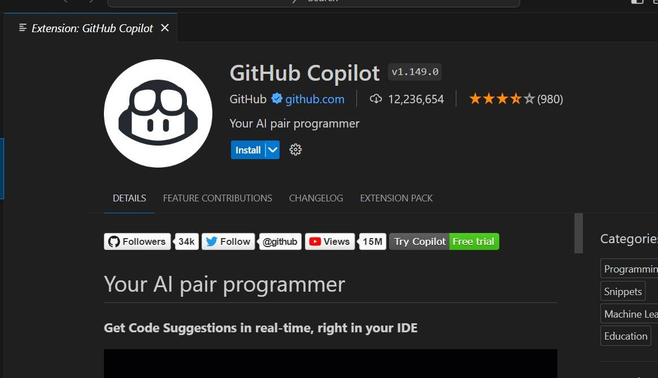
Install GitHub Copilot extension from the VS Code marketplace
To install GitHub Copilot extension, open VS Code and go to the extension marketplace. Search for GitHub Copilot and click install. The extension will be installed automatically.
Notes:
Once you have installed VS Code, you can install the GitHub Copilot extension from the VS Code marketplace.

Slide 23
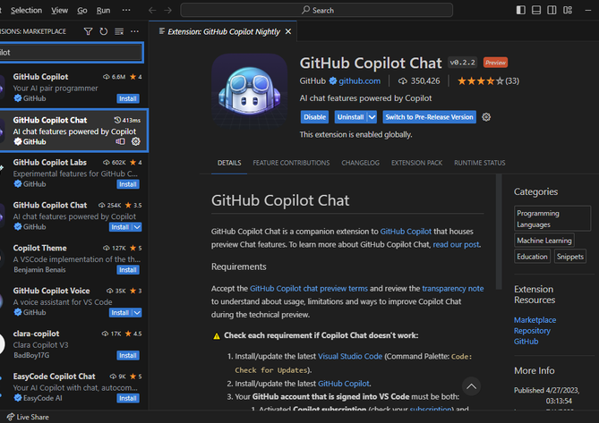
Enable Copilot in your VS Code settings
To enable GitHub Copilot in VS Code, go to the settings and enable the extension. Once enabled, you can start using Copilot to generate code snippets.
Notes:
To enable GitHub Copilot in VS Code, you need to go to your settings and enable the extension.

Slide 24
Conclusion
I hope this tutorial was helpful. Alternatively, you can check these Youtube videos.
https://www.youtube.com/watch?v=tRZGeaHPoaw&t=11s
https://www.youtube.com/watch?v=8Dd7KRpKeaE
https://www.youtube.com/watch?v=Oaj3RBIoGFc&t=10s
Notes:
GitHub is a powerful platform for collaborating on code and managing software projects. By following these 6 steps, you can get started with GitHub and start contributing to open source projects or building your own applications.

